Slide 1
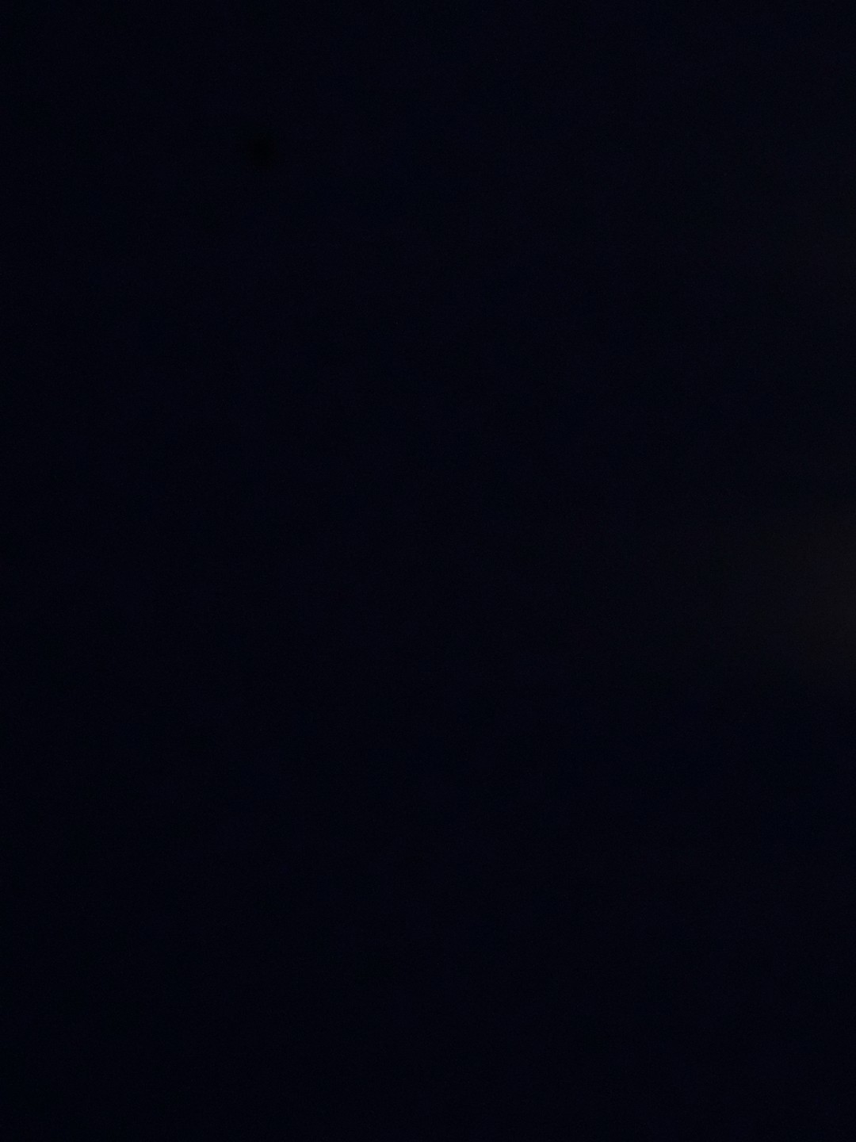

once in a
blood
moon
Everything blue is a guide. Delete it before you download.
Notes:
Slide 1. Hook. Swap in a photo of your product or shop.

Slide 2



our once-a-year
SALE
[see the deal]
Notes:
Slide 2. Second hook: Instagram often shows a carousel starting on slide 2, so this one works as a cover on its own. No photo needed. Edit both lines.

Slide 3


everything
30% off
Notes:
Slide 3. Swap in a photo for the moon window. Edit the deal.

Slide 4





this weekend only
Oct 29-31
Notes:
Slide 4. Swap in a photo of your product. Edit the dates.

Slide 5



[everything in the shop]
Notes:
Slide 5. Swap in a photo of your shop or the whole collection. Edit the line.

Slide 6





comment
MOON
for your code
Notes:
Slide 6. Type your keyword. Caption to start from (CTA in the first two sentences, 3 hashtags): Comment [KEYWORD] and I will send you [the link]. [One line of real context: who it helps or how you use it.] #[tag] #[tag] #[tag]

